Slide 1


Product Management Strategy Submission
November 24, 2018
Andrew J. Parker II

Slide 2
We as music producers look for any possible free time to create music as music gives us joy as well as others, with full control or at the very least as much control as possible. Touch-Won is designed for on-the-go music producers who are looking for a user-friendly and intuitive way to produce music.

Slide 3
Problem Statement
Touch-Won Music App
The pain of using a mobile music app is the lack of creativity due to a horrible sound bank, an unnerving learning curve based on a clumsy UI, time to create, and price.
Touch-Won intends to include a proper sound bank, to remove as much of the learning curve as possible by streamlining the UI, and present a price a user is willing to pay, while shortening the workflow as much as possible to create great music.

Slide 4
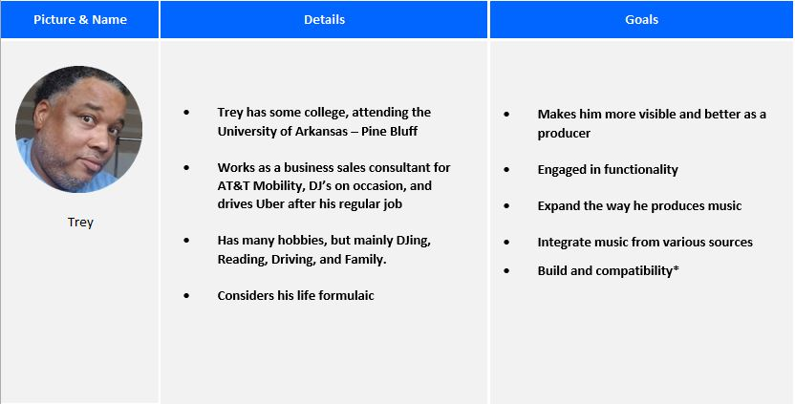
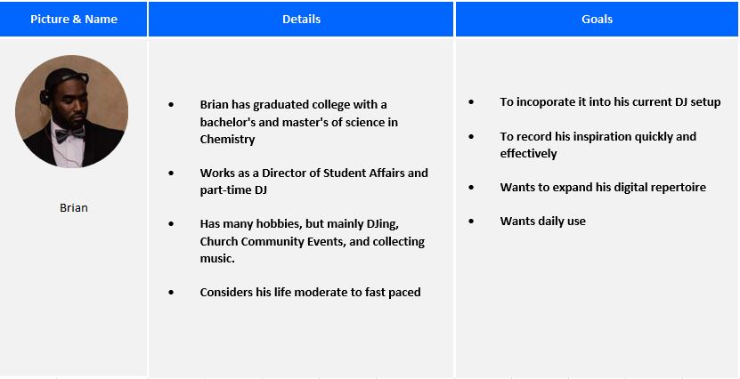
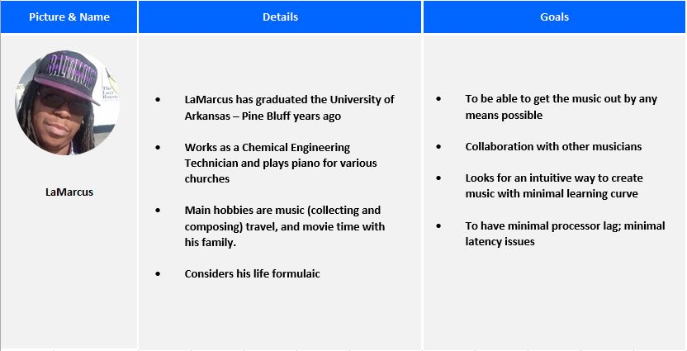
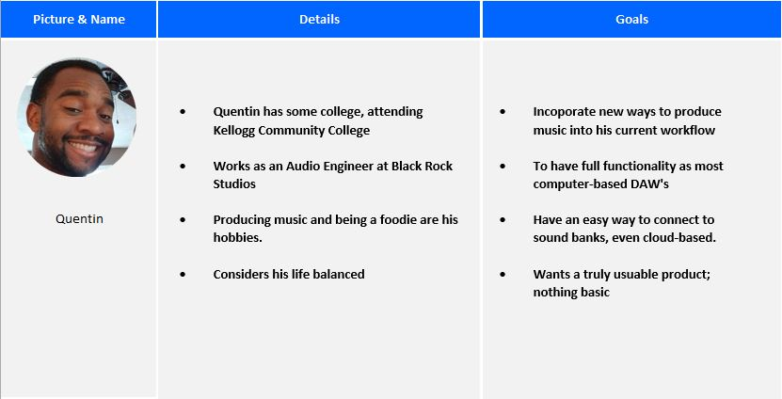
Customer Segments/Personas
Touch-Won Music App

Slide 5
Unique Value Proposition
Touch-Won Music App
Touch-Won aims to remove all or most obstacles on-the-go producers have by integrating top production features into one Android app.

Slide 6
MVP Definition
Touch-Won Music App
Touch-Won will use Kickstarter as a way to show the app to the user. Touch-Won will show high fidelity mock-ups showing the workflow.
This will measure user interest and price points simultaneously.

Slide 7
Thank you!

